Slide 1


Slide 2
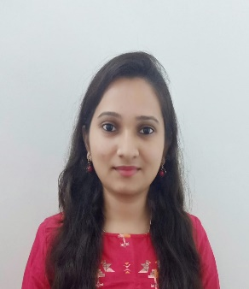
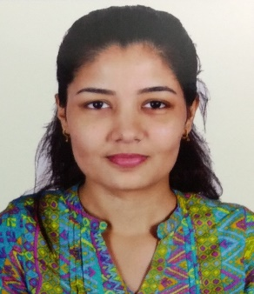
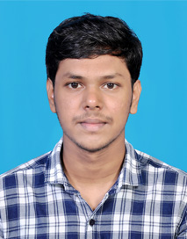
Project Highlights
Project Name : Android App Development: CodeIt: A Learning app programmers
Team Size : 3
BU Mentor Name : Mentor PS#
Vidyashree C V
99002492
2009MYSSPSB1
B.E in CSE
C, Java, HTML, CSS
Ria Singh
99002544
2009MYSSPSB1
B.Tech CSE
HTML, JavaScript, Java
Intern Name
99002647
2009MYSSPSB1
M.Tech CSE
C, C++, Java, Python

Slide 3
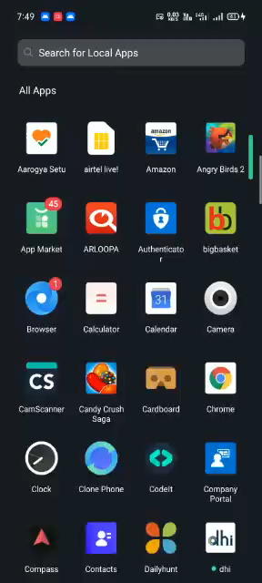
Project Video Snippet

Slide 4
Future development that can be implemented further
Recycler view in detail page
UI/UX improvements
More Courses

Slide 5


Thank You !

